Slide 1
COMPILER CONSTRUCTION

Slide 2
COURSE OUTCOMES
1 Compare different language Processors and design Lexical Analyzer for a given language.
2 Design Parser using top down and bottom up parsing techniques
3 Generate Intermediate code for a given set of instructions
4 Choose a data structures for symbol table organization and dynamic memory management
5 Apply various code optimization techniques to generate efficient target code

Slide 3
UNIT-I
Introduction: Language Processors, The structure of the compiler,
The science of building compiler.
Lexical analysis: The role of Lexical Analyzer, Input Buffering,
Specification of Tokens. Recognition of Tokens, The Lexical-Analyzer
Generator LEX.
UNIT-II
Syntax Analysis: Introduction, Context free grammars, Writing a
grammar, Top-Down parsing- Bottom-Up parsing, More powerful LR
parsers, Using ambiguous grammars, Parser Generators .
UNIT-III
Syntax Directed Translation: Syntax Directed Definitions,
Evaluation Orders for SDDs, Applications of Syntax Directed
Translation.
Intermediate code generation: Introduction, Variants of syntax
trees, Three-Address Code, Types and Declarations, Translation of
Expressions, Type Checking. Control Flow.
UNIT-IV
Run-time Environments: Storage Organization, Stack Allocation of Space, Access to Non local Data on the Stack. Heap Management, Introduction to Garbage Collection
Symbol Table Organization: Structure of Symbol table, Symbol
Table organization for Block Structured and non block Structure
languages, Data Structures of symbol Table.
UNIT-V
Code Generation: Issues in the Design of a Code Generator, The
Target Language, Addresses in the Target Code Basic Blocks and Flow Graphs.
Code Optimization: Optimization of Basic Blocks. Peephole
Optimization, Register Allocation and Assignment, Machine
Independent Optimizations – The Principal Sources of Optimizations, Introduction to data flow analysis.

Slide 4
TEXT BOOK
Alfred V Aho, Monica S Lam, Ravi Sethi, Jeffrey D Ullman,Compilers: Principles, Techniques & Tools, 2nd Edition(2022), Pearson Education.

Slide 5
UNIT-III
Syntax Directed Translation:
Syntax Directed Definitions,
Evaluation Orders for SDDs,
Applications of Syntax Directed Translation.
Intermediate code generation:
Introduction,
Variants of syntax trees,
Three-Address Code,
Types and Declarations,
Translation of Expressions,
Type Checking.
Control Flow.

Slide 6
Syntax-Directed Translation
We associate information with the programming language constructs by attaching attributes to grammar symbols.
(SDT= CFG + Semantic rules)
Values of these attributes are evaluated by the semantic rules associated with the production rules.
Evaluation of these semantic rules:
may generate intermediate codes
may put information into the symbol table
may perform type checking
may issue error messages
may perform some other activities
in fact, they may perform almost any activities.
An attribute may hold almost any thing.
a string, a number, a memory location, a complex record.
6
Notes:
6

Slide 7
Syntax Directed Translation has augmented rules to the grammar that facilitate semantic analysis.
SDT involves passing information bottom-up and/or top-down to the parse tree in form of attributes attached to the nodes.
Syntax-directed translation rules use
1) lexical values of nodes,
2) constants &
3) attributes associated with the non-terminals in their definitions.
The general approach to Syntax-Directed Translation is to construct a parse tree or syntax tree and compute the values of attributes at the nodes of the tree by visiting them in some order. In many cases, translation can be done during parsing without building an explicit tree.

Slide 8
Syntax-Directed Definitions and Translation Schemes
When we associate semantic rules with productions, we use two notations:
Syntax-Directed Definitions
Translation Schemes
Syntax-Directed Definitions:
give high-level specifications for translations
hide many implementation details such as order of evaluation of semantic actions.
We associate a production rule with a set of semantic actions, and we do not say when they will be evaluated.
Translation Schemes:
indicate the order of evaluation of semantic actions associated with a production rule.
In other words, translation schemes give a little bit information about implementation details.
8

Slide 9

Syntax-Directed Translation
Conceptually with both the syntax directed translation and translation scheme we
Parse the input token stream
Build the parse tree
Traverse the tree to evaluate the semantic rules at the parse tree nodes.
9

Slide 10
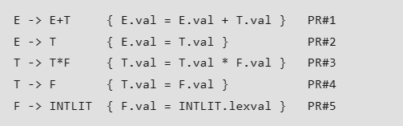
E -> E+T | T
T -> T*F | F
F -> INTLIT
Grammar to syntactically validate an expression having additions and multiplications in it

Slide 11
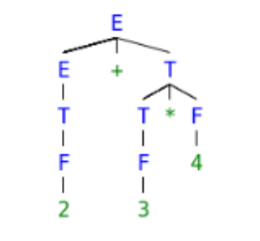
To evaluate translation rules, we can employ one depth-first search traversal on the parse tree.
This is possible only because SDT rules don’t impose any specific order on evaluation until children’s attributes are computed before parents for a grammar having all synthesized attributes.
Parse tree corresponding to S would be
S = 2+3*4.

Slide 12
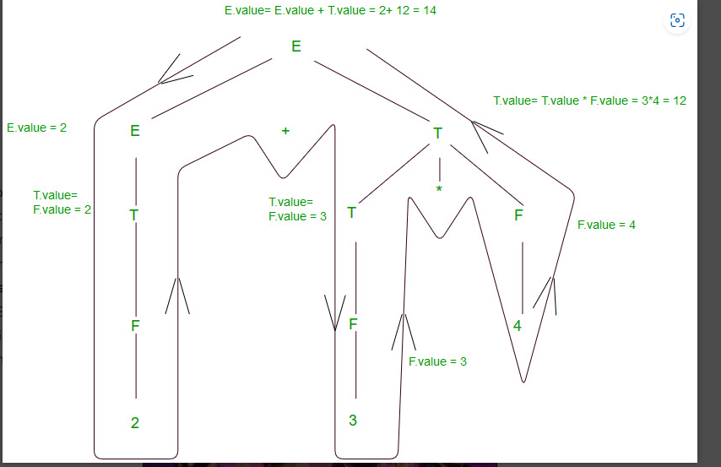

Slide 13
Synthesized Attributes are such attributes that depend only on the attribute values of children nodes.
[ E -> E+T { E.val = E.val + T.val } ] has a synthesized attribute val
corresponding to node E. If all the semantic attributes in an augmented grammar are synthesized, one depth-first search traversal in any order is sufficient for the semantic analysis phase.
Inherited Attributes are such attributes that depend on parent and/or sibling’s attributes.
[ Ep -> E+T { Ep.val = E.val + T.val, T.val = Ep.val } ], where E & Ep are same production symbols annotated to differentiate between parent and child, has an inherited attribute val corresponding to node T.

Slide 14
Advantages of Syntax Directed Translation:
Ease of implementation: SDT is a simple and easy-to-implement method for translating a programming language. It provides a clear and structured way to specify translation rules using grammar rules.
Separation of concerns: SDT separates the translation process from the parsing process, making it easier to modify and maintain the compiler. It also separates the translation concerns from the parsing concerns, allowing for more modular and extensible compiler designs.
Efficient code generation: SDT enables the generation of efficient code by optimizing the translation process. It allows for the use of techniques such as intermediate code generation and code optimization.

Slide 15
Disadvantages of Syntax Directed Translation:
Limited expressiveness: SDT has limited expressiveness in comparison to other translation methods, such as attribute grammars. This limits the types of translations that can be performed using SDT.
Inflexibility: SDT can be inflexible in situations where the translation rules are complex and cannot be easily expressed using grammar rules.
Limited error recovery: SDT is limited in its ability to recover from errors during the translation process. This can result in poor error messages and may make it difficult to locate and fix errors in the input program.

Slide 16
Application of Syntax Directed Translation
SDT is used for Executing Arithmetic Expression.
In the conversion from infix to postfix expression.
In the conversion from infix to prefix expression.
It is also used for Binary to decimal conversion.
In counting number of Reduction.
In creating a Syntax tree.
SDT is used to generate intermediate code.
In storing information into symbol table.
SDT is commonly used for type checking also.

Slide 17
Types of attributes
Attributes may be of two types – Synthesized or Inherited.
Synthesized attributes – A Synthesized attribute is an attribute of the non-terminal on the left-hand side of a production.
Synthesized attributes represent information that is being passed up the parse tree. The attribute can take value only from its children (Variables in the RHS of the production).
The non-terminal concerned must be in the head (LHS) of production. For e.g. let’s say A -> BC is a production of a grammar, and A’s attribute is dependent on B’s attributes or C’s attributes then it will be synthesized attribute.

Slide 18
Inherited attributes – An attribute of a non terminal on the right-hand side of a production is called an inherited attribute.
The attribute can take value either from its parent or from its siblings (variables in the LHS or RHS of the production).
The non-terminal concerned must be in the body (RHS) of production.
For example, let’s say A -> BC is a production of a grammar and B’s attribute is dependent on A’s attributes or C’s attributes then it will be inherited attribute because A is a parent here, and C is a sibling.

Slide 19
S-attributed SDT
If an SDT uses only synthesized attributes, it is called as S-attributed SDT.
S-attributed SDTs are evaluated in bottom-up parsing, as the values of the parent nodes depend upon the values of the child nodes.
Semantic actions are placed in rightmost place of RHS.

Slide 20
L-attributed SDT:
If an SDT uses both synthesized attributes and inherited attributes with a restriction that inherited attribute can inherit values from left siblings only, it is called as L-attributed SDT.
Attributes in L-attributed SDTs are evaluated by depth-first and left-to-right parsing manner.
Semantic actions are placed anywhere in RHS.
Example : S->ABC, Here attribute B can only obtain its value either from the parent – S or its left sibling A but It can’t inherit from its right sibling C. Same goes for A & C – A can only get its value from its parent & C can get its value from S, A, & B as well because C is the rightmost attribute in the given production.

Slide 21
Evaluation Order For SDD
Evaluation order for SDD includes how the SDD(Syntax Directed Definition) is evaluated with the help of attributes, dependency graphs, semantic rules, and S and L attributed definitions.
SDD helps in the semantic analysis in the compiler so it’s important to know about how SDDs are evaluated and their evaluation order.

Slide 22
Dependency Graphs
A dependency graph provides information about the order of evaluation of attributes with the help of edges. It is used to determine the order of evaluation of attributes according to the semantic rules of the production. An edge from the first node attribute to the second node attribute gives the information that first node attribute evaluation is required for the evaluation of the second node attribute. Edges represent the semantic rules of the corresponding production.
Dependency Graph Rules: A node in the dependency graph corresponds to the node of the parse tree for each attribute. Edges (first node from the second node)of the dependency graph represent that the attribute of the first node is evaluated before the attribute of the second node.

Slide 23
Ordering the Evaluation of Attributes
The dependency graph provides the evaluation order of attributes of the nodes of the parse tree.
An edge( i.e. first node to the second node) in the dependency graph represents that the attribute of the second node is dependent on the attribute of the first node for further evaluation. This order of evaluation gives a linear order called topological order.
There is no way to evaluate SDD on a parse tree when there is a cycle present in the graph and due to the cycle, no topological order exists.

Slide 24
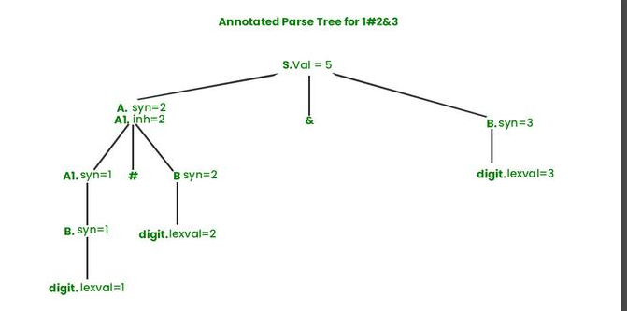
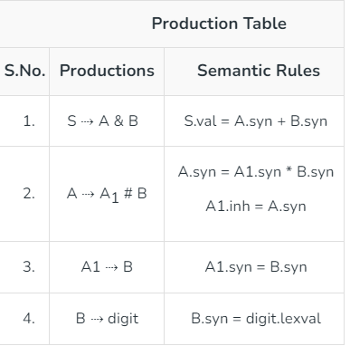

Slide 25
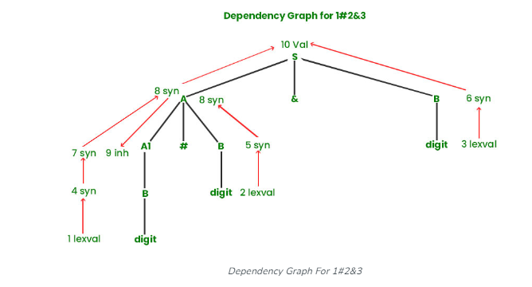

Slide 26
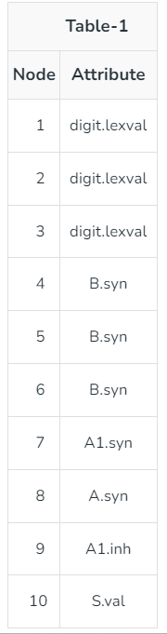
Table-1 represents the attributes corresponding to each node. Table-2 represents the semantic rules corresponding to each edge.

Slide 27
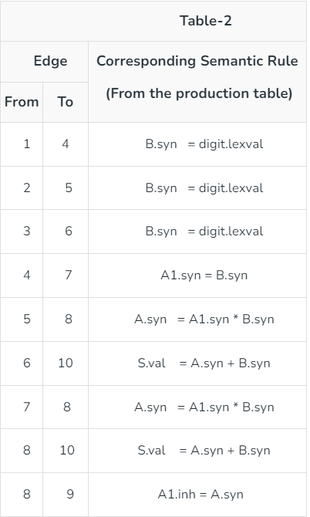

Slide 28
S-Attributed Definitions
S-attributed SDD can end of the production only. Its evaluation is based on bottom up parsing. Yacc is based on the S-attributed approach. Any S-attributed grammar is also an L-attributed grammar. have only synthesized attributes. In this type of definitions semantic rules are placed at the
Example: S ⇢ AB { S.x = f(A.x | B.x) }
Every S-attributed grammar is also L-attributed.
For L-attributed evaluation in order of the annotated parse tree is used.
For S-attributed reverse of the rightmost derivation is used.

Slide 29
L-Attributed Definitions
L-attributed SDD can have both synthesized and inherited (restricted inherited as attributes can only be taken from the parent or left siblings).
In this type of definition, semantics rules can be placed anywhere in the RHS of the production. Its evaluation is based on in order (topological sorting).
Example:
S ⇢ AB {A.x = S.x + 2} or
S ⇢ AB { B.x = f(A.x | B.x) } or
S ⇢ AB { S.x = f(A.x | B.x) }.

Slide 30
Parse Tree: A parse tree is a tree that represents the syntax of the production hierarchically.
Annotated Parse Tree: Annotated Parse tree contains the values and attributes at each node.
Synthesized Attributes: When the evaluation of any node’s attribute is based on children.
Inherited Attributes: When the evaluation of any node’s attribute is based on children or parents.

Slide 31
Examples:
Synthesized attribute : E→E1+E2 { E.val =E1.val + E2.val}
Inherited attribute :A→XYZ {Y.val = 2 * A.val}
Semantic rules set up dependencies between attributes which can be represented by a dependency graph.
This dependency graph determines the evaluation order of these semantic rules.
Evaluation of a semantic rule defines the value of an attribute. But a semantic rule may also have some side effects such as printing a value.
31

Slide 32
Annotated Parse Tree
A parse tree showing the values of attributes at each node is called an annotated parse tree.
2. Values of Attributes in nodes of annotated parse-tree are either,
initialized to constant values or by the lexical analyzer.
determined by the semantic-rules.
3. The process of computing the attributes values at the nodes is called annotating (or decorating) of the parse tree.
4. Of course, the order of these computations depends on the dependency graph induced by the semantic rules.
32

Slide 33
Syntax-Directed Definition
In a syntax-directed definition, each production A→α is associated with a set of semantic rules of the form:
b=f(c₁,c₂,…,c_{n})
where f is a function and b can be one of the followings:
🡺 b is a synthesized attribute of A and c₁,c₂,…,c_{n} are attributes of the grammar symbols in the production ( A→α).
OR
🡺 b is an inherited attribute one of the grammar symbols in α (on the right side of the production), and c₁,c₂,…,c_{n} are attributes of the grammar symbols in the production ( A→α).
33

Slide 34
Attribute Grammar
So, a semantic rule b=f(c₁,c₂,…,c_{n}) indicates that the attribute b depends on attributes c₁,c₂,…,c_{n}.
In a syntax-directed definition, a semantic rule may just evaluate a value of an attribute or it may have some side effects such as printing values.
An attribute grammar is a syntax-directed definition in which the functions in the semantic rules cannot have side effects (they can only evaluate values of attributes).
34

Slide 35
Production Semantic Rules
L → E n print(E.val)
E → E₁ + T E.val = E₁.val + T.val
E → T E.val = T.val
T → T₁ * F T.val = T₁.val * F.val
T → F T.val = F.val
F → ( E ) F.val = E.val
F → digit F.val = digit.lexval
1. Symbols E, T, and F are associated with a synthesized attribute val.
The token digit has a synthesized attribute lexval (it is assumed that it is evaluated by the lexical analyzer).
Terminals are assumed to have synthesized attributes only. Values for attributes of terminals are usually supplied by the lexical analyzer.
The start symbol does not have any inherited attribute unless otherwise stated.
35

Slide 36
S-attributed definition
A syntax directed translation that uses synthesized attributes exclusively is said to be a S-attributed definition.
A parse tree for a S-attributed definition can be annotated by evaluating the semantic rules for the attributes at each node, bottom up from leaves to the root.
36

Slide 37
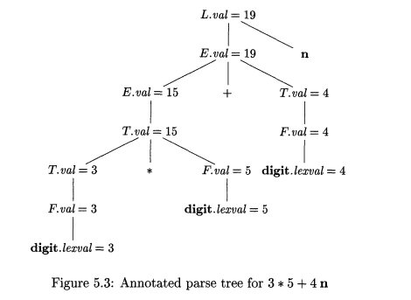

Slide 38
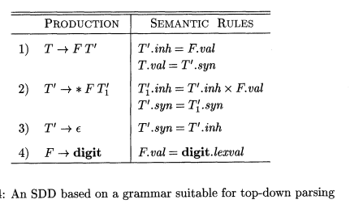

Slide 39
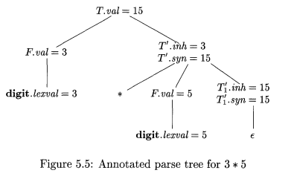

Slide 40
Inherited attributes
An inherited value at a node in a parse tree is defined in terms of attributes at the parent and/or siblings of the node.
Convenient way for expressing the dependency of a programming language construct on the context in which it appears.
We can use inherited attributes to keep track of whether an identifier appears on the left or right side of an assignment to decide whether the address or value of the assignment is needed.
Example: The inherited attribute distributes type information to the various identifiers in a declaration.
40

Slide 41
Syntax-Directed Definition – Inherited Attributes
Production Semantic Rules
D → T L L.in = T.type
T → int T.type = integer
T → real T.type = real
L → L₁ id L₁.in = L.in, addtype(id.entry,L.in)
L → id addtype(id.entry,L.in)
Symbol T is associated with a synthesized attribute type.
Symbol L is associated with an inherited attribute in.
41

Slide 42
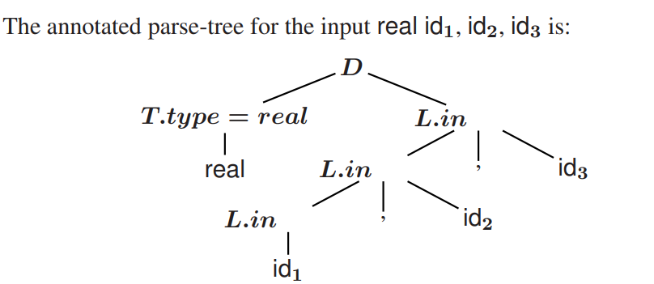

Slide 43
Dependency Graph
Directed Graph
Shows interdependencies between attributes.
If an attribute b at a node depends on an attribute c, then the semantic rule for b at that node must be evaluated after the semantic rule that defines c.
Construction:
Put each semantic rule into the form b=f(c₁,…,c_{k}) by introducing dummy synthesized attribute b for every semantic rule that consists of a procedure call.
E.g.,
L → E n print(E.val)
Becomes: dummy = print(E.val)
The graph has a node for each attribute and an edge to the node for b from the node for c if attribute b depends on attribute c.
43

Slide 44
Dependency Graph Construction
for each node n in the parse tree do
for each attribute a of the grammar symbol at n do
construct a node in the dependency graph for a
for each node n in the parse tree do
for each semantic rule b = f(c₁,…,c_{n})
associated with the production used at n do
for i= 1 to n do
construct an edge from the node for c_{i} to the node for b
44

Slide 45
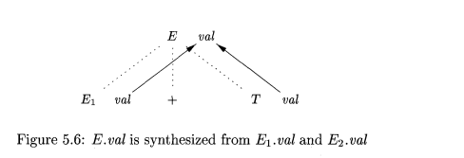
Dependency Graph Construction
Example
Production Semantic Rule
E→E1 + E2 E.val = E1.val + E2.val
E.val is synthesized from E1.val and E2.val
The dotted lines represent the parse tree that is not part of the dependency graph.
45

Slide 46
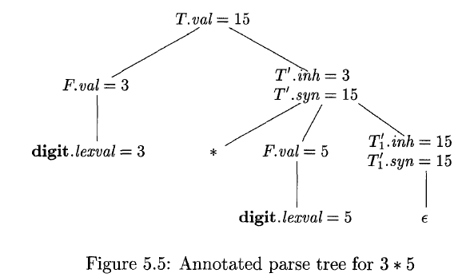
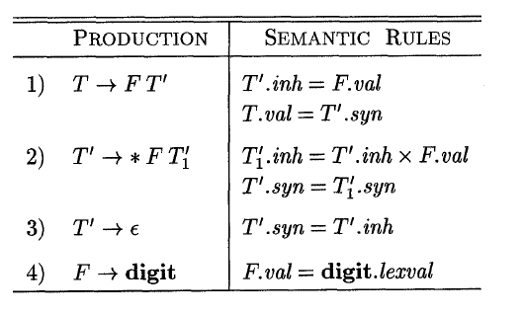
46

Slide 47
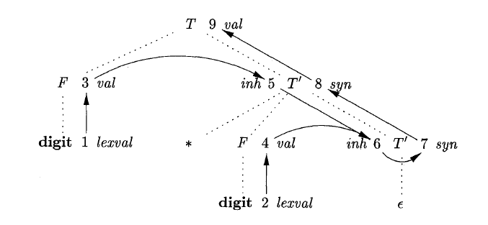
Nodes 1 and 2 represent the attribute lexval associated with the two leaves labeled digit. Nodes 3 and 4 represent the attribute val associated with the two nodes labeled F. The edges to node 3 from 1 and to node 4 from 2 result from the semantic rule that defines F.ual in terms of digit.lexva1. In fact, F.ual equals digit.lexval, but the edge represents dependence, not equality.
47

Slide 48
Nodes 5 and 6 represent the inherited attribute T1.inh associated with each of the occurrences of non terminal TI.
The edge to 5 from 3 is due to the rule T1.inh = F.val, which defines T1.inh at the right child of the root from F.ua1 at the left child.
Edges to 6 from node 5 for T1.inh and from node 4 for F.val, because these values are multiplied to evaluate the attribute inh at node 6.
Nodes 7 and 8 represent the synthesized attribute syn associated with the occurrences of TI.
The edge to node 7 from 6 is due to the semantic rule T1.syn = T1.inh associated with production.
The edge to node 8 from 7 is due to a semantic rule associated with production 2. Finally, node 9 represents the attribute T.ual. The edge to 9 from 8 is due to the semantic rule, T. val = T1.syn, associated with production 1.
48

Slide 49
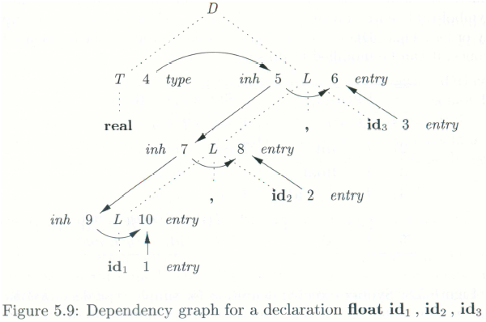
Dependency Graph
D → T L L.in = T.type
T → int T.type = integer
T → real T.type = real
L → L₁ id L₁.in = L.in, addtype(id.entry,L.in)
L → id addtype(id.entry,L.in)
49

Slide 50
Evaluation Order
Numbers 1 through 10 represent the nodes of the dependency graph.
Nodes 1, 2, and 3 represent the attribute entry associated with each of the leaves labeled id. Nodes 6, 8, and 10 are the dummy attributes that represent the application of the function addType to a type and one of these entry values.
50

Slide 51
Evaluating Semantic Rules
Parse Tree methods
At compile time evaluation order obtained from the topological sort of dependency graph.
Fails if dependency graph has a cycle
Rule Based Methods
Semantic rules analyzed by hand or specialized tools at compiler construction time
Order of evaluation of attributes associated with a production is pre-determined at compiler construction time
Oblivious Methods
Evaluation order is chosen without considering the semantic rules.
Restricts the class of syntax directed definitions that can be implemented.
If translation takes place during parsing order of evaluation is forced by parsing method.
51

Slide 52
Syntax Trees
Syntax-Tree
an intermediate representation of the compiler’s input.
Syntax tree shows the syntactic structure of the program while omitting irrelevant details.
Operators and keywords are associated with the interior nodes.
Chains of simple productions are collapsed.
Syntax directed translation can be based on syntax tree as well as parse tree.
52

Slide 53
Syntax Tree-Examples
Expression:
+
5 *
3 4
Leaves: identifiers or constants
Internal nodes: labelled with operations
Children: of a node are its operands
if B then S1 else S2
if - then - else
Statement:
Node’s label indicates what kind of a statement it is
Children of a node correspond to the components of the statement
B S1 S2
53

Slide 54
Constructing Syntax Tree for Expressions
Each node can be implemented as a record with several fields.
Operator node: one field identifies the operator (called label of the node) and remaining fields contain pointers to operands.
The nodes may also contain fields to hold the values (pointers to values) of attributes attached to the nodes.
Functions used to create nodes of syntax tree for expressions with binary operator are given below.
mknode(op,left,right)
mkleaf(id,entry)
mkleaf(num,val)
Each function returns a pointer to a newly created node.
54

Slide 55
Constructing Syntax Tree for Expressions-
Example: a-4+c
p1:=mkleaf(id,entrya);
p2:=mkleaf(num,4);
3. p3:=mknode(-,p1,p2)
p4:=mkleaf(id,entryc);
p5:= mknode(+,p3,p4);
The tree is constructed bottom up.
+
-
id
to entry for c
id
num | 4
to entry for a
55

Slide 56
A Syntax Directed Definition for Constructing Syntax Tree
It uses underlying productions of the grammar to schedule the calls of the functions mkleaf and mknode to construct the syntax tree
Employment of the synthesized attribute nptr (pointer) for E and T to keep track of the pointers returned by the function calls.
PRODUCTION SEMANTIC RULE
E → E₁ + T E.nptr = mknode(“+”,E₁.nptr ,T.nptr)
E → E₁ - T E.nptr = mknode(“-”,E₁.nptr ,T.nptr)
E → T E.nptr = T.nptr
T → (E) T.nptr = E.nptr
T → id T.nptr = mkleaf(id, id.lexval)
T → num T.nptr = mkleaf(num, num.val)
56

Slide 57
Annotated parse tree depicting construction of syntax tree for the expression a-4+c
E.nptr
E.nptr + T.nptr
E.nptr - T.nptr
id
+
T.nptr num
-
id
id
Entry for c
id
num
Entry for a
57

Slide 58
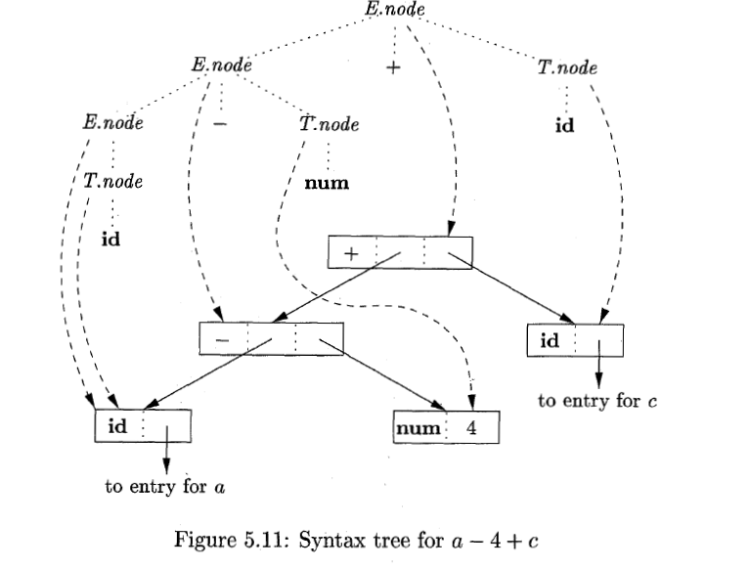
The nodes of the syntax tree are shown as records, with the op field first. Syntax-tree edges are now shown as solid lines.
The underlying parse tree, which need not actually be constructed, is shown with dotted edges.
The third type of line, shown dashed, represents the values of E.node and T.node; each line points to the appropriate syntax-tree node.
58

Slide 59
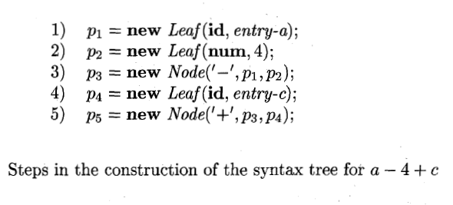
59

